Slide 1


SQL PROJECT (INTERSHALA)
NISHITA GOEL

Slide 2

IPL AUCTION

Slide 3
TASK 1 TO get 2-3 players with high S.R who have faced at least 500 balls
select batsman,round((sum(batsman_runs*1.0)/count(ball))*100,2) as strike_rate from ipl
where extras_type not in ('wides') group by batsman
having count(ball)>500 order by strike_rate desc limit 10;

Slide 4
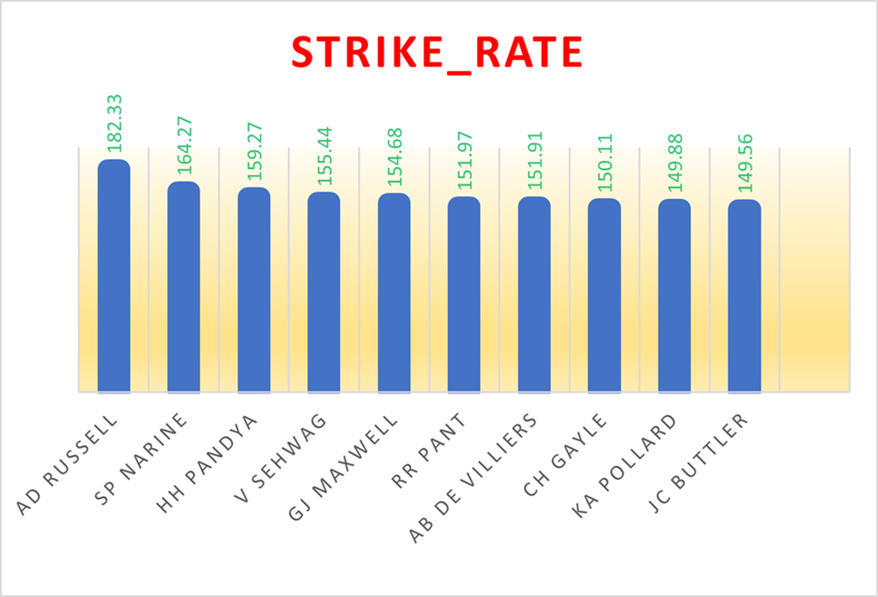
Batsman with high S.R
LIST OF 10 PLAYERS
TOP 3 PLAYERS

Slide 5
Task 2 To get 2-3 players with good Average who have played more than 2 ipl seasons
select a.batsman,sum(a.batsman_runs) as total_batsman_runs,sum(a.is_wicket) as total_wicket,count(distinct(extract(year from b.date)))as season,round(sum(a.batsman_runs)*1.0/sum(a.is_wicket)*1,2) as average from ipl as a inner join IPL_MATCHES as b on a.id=b.id group by a.batsman having sum(a.is_wicket)>0 and count(distinct(extract(year from b.date)))>2 order by average desc limit 10;

Slide 6
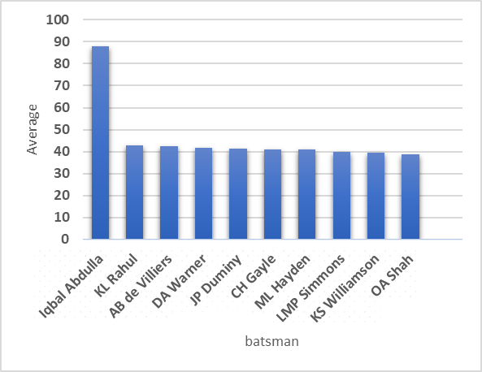
Batsman with good average
LIST OF 10 PLAYERS
TOP 3 PLAYERS

Slide 7
Task3 To get 2-3 Hard-hitting players who have scored most runs in boundaries and have played more the 2 ipl season
SELECT a.BATSMAN,SUM(a.BATSMAN_RUNS)AS TOTAL_RUNS, count(distinct(extract(year from b.date)))>2 as season,count(case when a.batsman_runs=4 or a.batsman_runs =6 then 1 else 0 end) as boundaries, round(SUM(a.BATSMAN_RUNS*1.0)/ count(case when a.batsman_runs=4 or a.batsman_runs =6 then 1 else 0 end)*100,2) as hard_hitting_player from ipl as a inner join ipl_matches as b on a.id=b.id group by a.batsman having count(distinct(extract(year from b.date)))>2 order by hard_hitting_player desc limit 10 ;

Slide 8
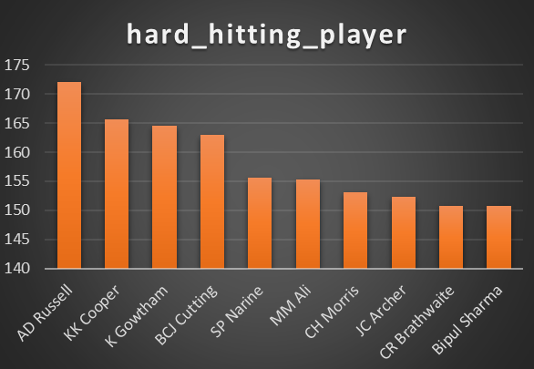
Hard-hitting players
TOP 10 PLAYERS
TOP 3 PLAYERS

Slide 9
Task 4 To get 2-3 bowlers with good economy who have bowled at least 500 balls in IPL so far
SELECT BOWLER, ROUND(SUM(total_runs)/(COUNT(Bowler)/6.0),2) AS ECONOMY FROM IPL GROUP BY BOWLER HAVING COUNT(Bowler)>500 ORDER BY ECONOMY LIMIT 10;

Slide 10

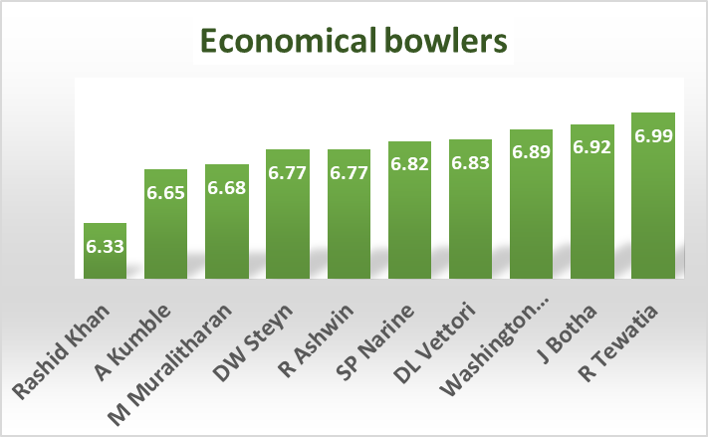
bowlers with good economy
TOP 10 BOWLER
TOP 3 BOWLER

Slide 11
Task 5
To get 2-3 bowlers with the best strike rate and who have bowled at least 500 balls in IPL
select bowler, is_wicket,case when dismissal_kind in ('bowled',
'caught',
'caught and bowled',
'hit wicket',
'lbw',
'run out',
'stumped') then 1 else 0 end as dismissal_type from ipl ;
create table valid_dismissals as (select bowler, is_wicket,case when dismissal_kind in ('bowled',
'caught',
'caught and bowled',
'hit wicket',
'lbw',
'run out',
'stumped') then 1 else 0 end as dismissal_type from ipl )

Slide 12
select bowler, round(count(bowler)*1.0/sum(dismissal_type),2) as strike_rate_bowler from valid_dismissals group by bowler having count(bowler)>500 order by strike_rate_bowler limit 10;

Slide 13
Task6 To get 2-3 All_rounders with the best batting as well as bowling strike rate and who have faced at least 500 balls in IPL
select a.batsman,round((sum(a.batsman_runs*1.0)/count(a.ball))*100,2) as strike_rate_batsman from ipl as a inner join ( select b.bowler, round(count(b.bowler)*1.0/sum(b.dismissal_type),2) as strike_rate_bowler from valid_dismissals as b group by bowlerhaving count(bowler)>300) as b on a.batsman=b.bowler where extras_type not in ('wides')group by a.batsman, b.bowler having count(ball)>500 order by strike_rate_batsman desc limit 10;

Slide 14
wicketkeeper
Reflexes Quick reflexes are one of the most important skills for wicketkeepers it need to have excellent hand-eye coordination and spatial awareness.Having these skills, a keeper will be able to react quickly on the field, and there’s nothing more important than reactions in wicketkeeping.
Footwork Feet movement helps wicketkeepers collect hard-to-reach balls .In order to cover a larger area behind the stumps, wicketkeepers need to have good footwork. It makes a huge difference, especially when wicketkeeper have to keep in longer formats
Glove work Handling the ball and glove work are important for wicketkeeper. wicketkeeper is only as good as their ability with their hands; more specifically, how they handle the ball when it lands in their gloves
Deflection Keepers need to be ready for nicks and edges Flicks and edges off the bat or pads are common in the sport, and it is important for the keeper to replicate such scenarios during training sessions.
While selecting the wicketkeeper we can follow the above criteria and the person who has the above abilty can be our wicketkeeper. Also while selecting the wicketkeeper we should should not pay the amount greater than we have in the purse for a particular player

Slide 15
Additional Questions for Final Assessment
TO CREATE TABLE
Create table deliveries as (select * from ipl);
create table matches as (select * from ipl_matches);

Slide 16
1….
To count of cities that have hosted an IPL match
select count(distinct (city)) as count_city from ipl_matches;
2……
To Create table deliveries_v02
create table deliveries_v02 as (select *,case when total_runs >=4 then 'boundary' when total_runs=0 then'dot' else 'other' end as ball_result from deliveries);

Slide 17
3……. To fetch the total number of boundaries and dot balls select count(ball_result) as no_of_boundaries,(select count(ball_result) as dot from deliveries_v02 where ball_result='dot'), count(ball_result) as boundary from deliveries_v02 where ball_result= 'boundary'

Slide 18
4…
To fetch the total number of boundaries scored by each team
for bowling_team
select bowling_team,count(ball_result) as boundaries from deliveries_v02 where ball_result= 'boundary' group by bowling_team order by boundaries desc;
For batting _team
select batting_team ,count(ball_result) as boundaries from deliveries_v02 where ball_result= 'boundary' group by batting_team order by boundaries desc;

Slide 19
The total number of boundaries scored by each team
For bowling_team
for batting_team

Slide 20
5…
To fetch the total number of dot balls bowled by each team
select bowling_team,count(ball_result) as boundaries from deliveries_v02 where ball_result= ‘dot’ group by bowling_team order by boundaries desc;

Slide 21
6…
To fetch the total number of dismissals
select count(dismissal_kind) as dismissal from deliveries_v02 where dismissal_kind not in ('NA')

Slide 22
7..
To get the top 5 bowlers who conceded maximum extra runs
SELECT BOWLER,SUM(EXTRA_RUNS) as max_runs FROM deliveries GROUP BY BOWLER ORDER BY SUM(EXTRA_RUNS)DESC LIMIT 5

Slide 23
8…..
To create a table named deliveries_v03
CREATE TABLE deliveries_v03 AS( SELECT A.* ,B.VENUE ,B.DATE FROM deliveries_v02 AS A inner join MATCHES AS B on A.ID=B.ID)
9…
To fetch the total runs scored for each venue
select * from deliveries_v03; select venue, sum(total_runs) as total_runs from deliveries_v03 group by total_runs venue order by total_runs desc;

Slide 24

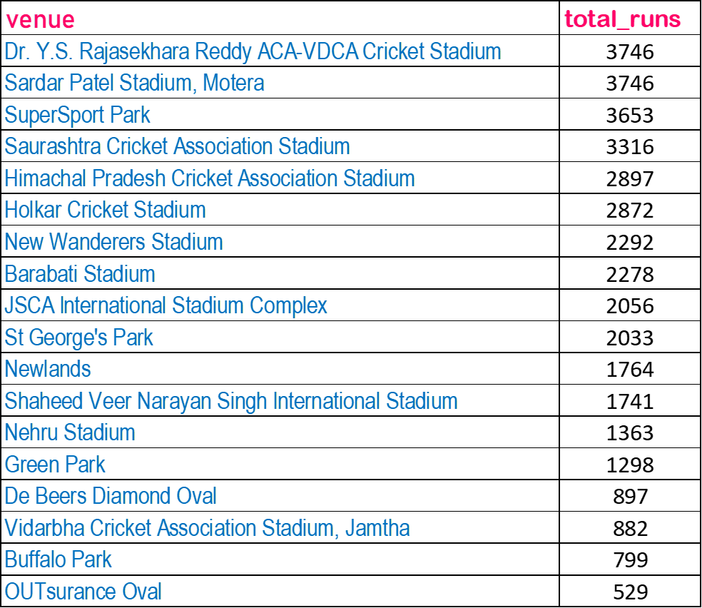

Slide 25
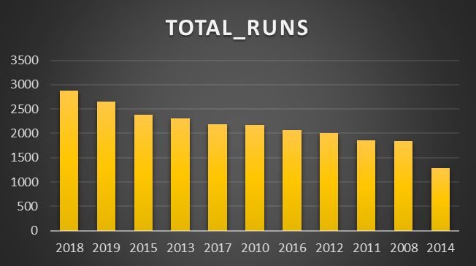
10….
TO fetch the year-wise total runs scored at Eden Gardens select extract(year from date)as year ,sum(total_runs) as total_runs from deliveries_v03 where venue ='Eden Gardens' group by extract(year from date)order by total_runs desc

Slide 26
THANK YOU

